Slide 1
Eco-helpers
Unit 8 b

Slide 2
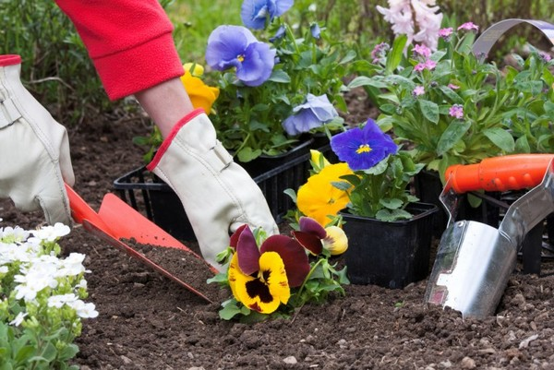
Plant flowers

Slide 3
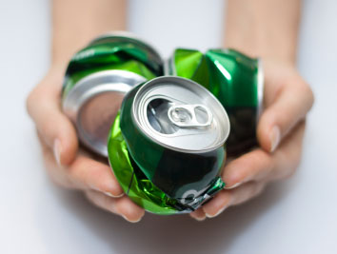
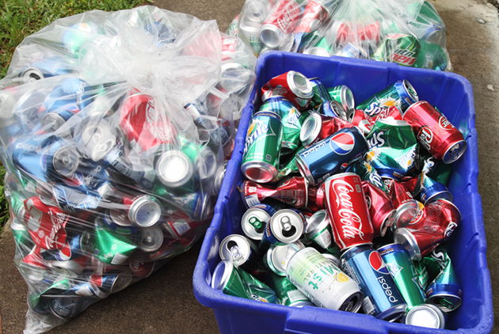
Recycle cans

Slide 4
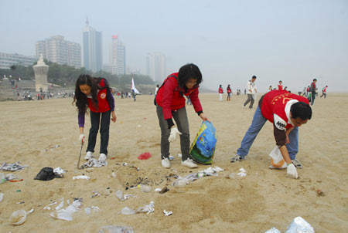
Collect rubbish

Slide 5
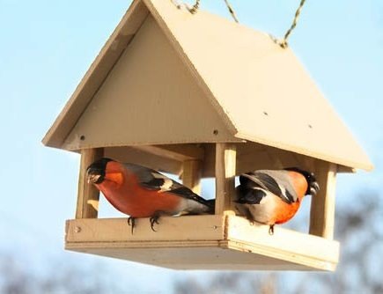
Build nesting boxes

Slide 6
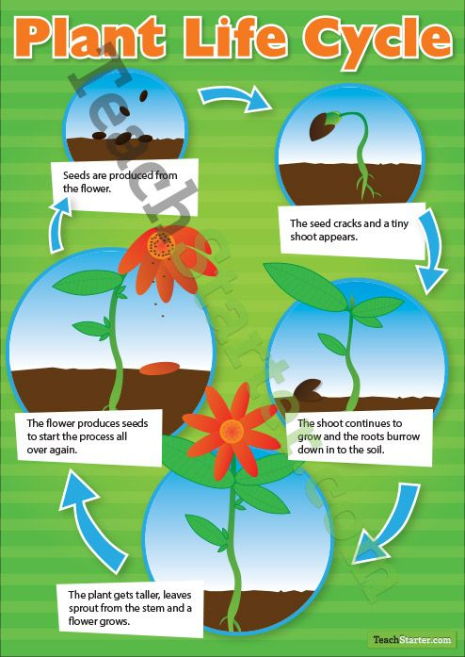
Teach the cycle of life

Slide 7
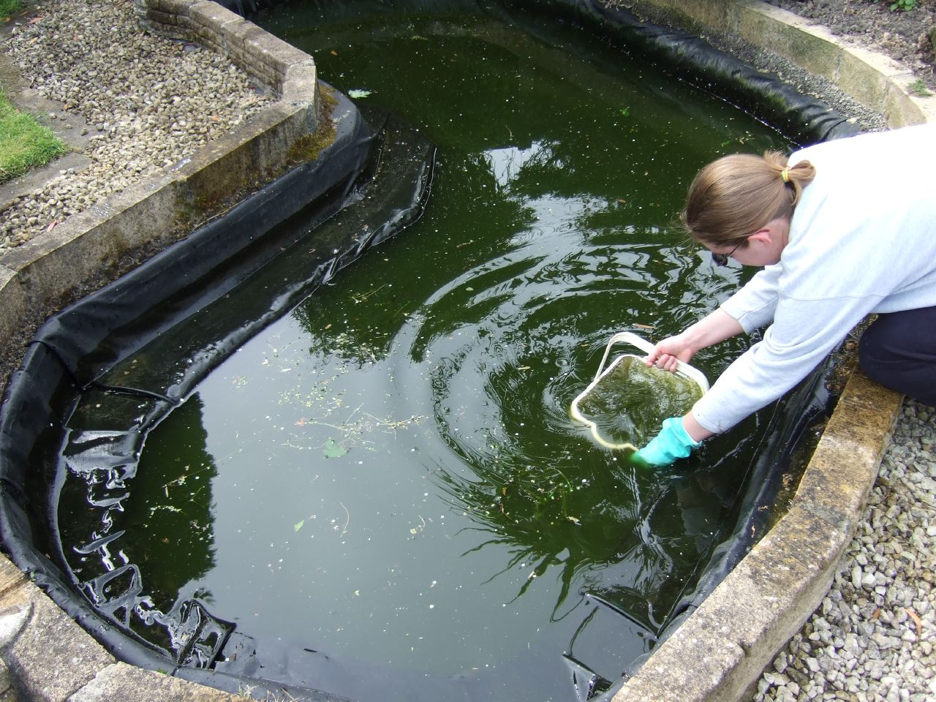
Clean out a pond

Slide 8
Read a book about ecology

Slide 9
Look at the picture of the Ex.1, p.78. What is each person in the picture doing?
Dave is planting flowers.

Slide 10
A ladder

Slide 11
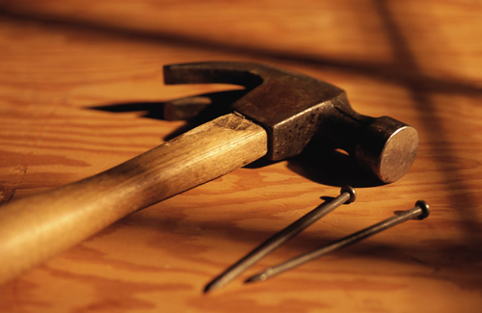
A hammer and nails

Slide 12
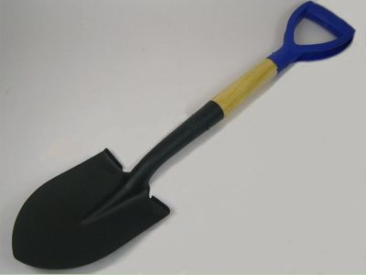
A spade

Slide 13
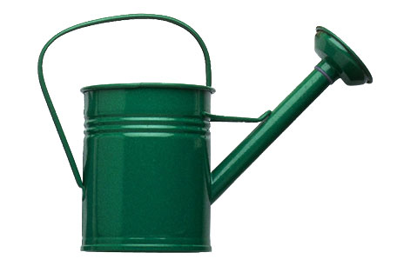
A watering can

Slide 14
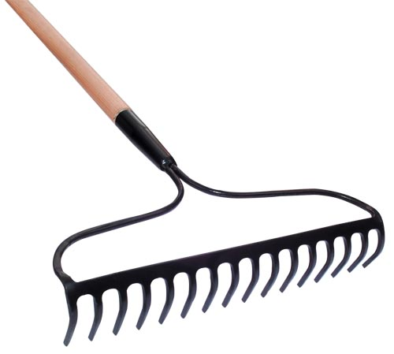
A rake

Slide 15
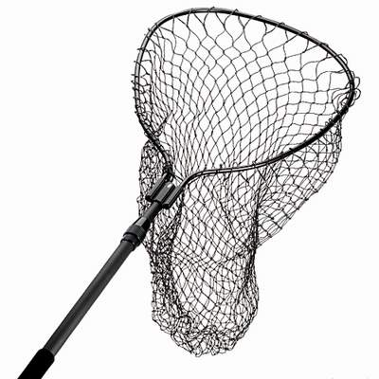
A net

Slide 16
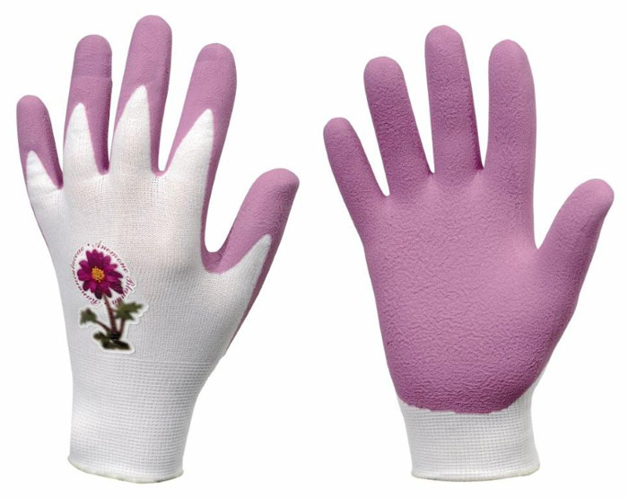
Gardening gloves

Slide 17
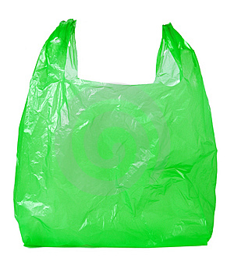
A plastic bag

Slide 18
What are they using them for?
Sally is using a ladder to collect rubbish from the tree house.

Slide 19
Read the dialoge and complete the sentenses.(Ex.3, p.78)
Sally __________________for a month
Dave’s been_____________________.
The birds will leave the city if_____________________________
Tim wants to _______________onMonday morning.
has been collecting rubbish for recycling
building nesting boxes
we don’t help them
join the club

