Slide 1
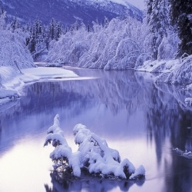
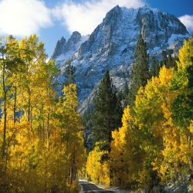
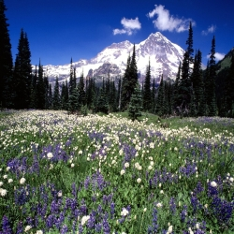
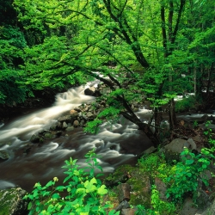
УРОК-ПРЕЗЕНТАЦИЯ «SEASONS AND THE WEATHER»

Slide 2
The weather can be:
sunny
rainy
snowy
cloudy
windy
stormy
foggy
frosty

Slide 3
Match seasons and the words meaning the weather.
Winter
Spring
Summer
Autumn
sunny rainy
snowy cloudy
windy stormy
foggy frosty,
cold hot
warm cool

Slide 4
Find the odd words.
Frosty, cold, snowy, warm
Rainy, stormy, foggy, sunny
Spring, autumn, winter, sky
Blow, snow, rain, hot

Slide 5
Make up sentences.
The weather is
winter
spring
in summer
autumn

Slide 6
Make up sentences.
The wind is sunny in July
The weather is grey in winter
The sky are short in autumn
The sun blows in summer
The days snows in January
It shines in winter

Slide 7
Make up sentences and translate them.
1. it / autumn / often / in / rains.
2. don’t / to school / in summer / go
/ children.
3. songs / birds / in summer / sing.
4. cold / blows / a / in winter / wind.
5. in May / are / leaves / green.

Slide 8
Ask questions about the weather.
winter ?
sunny
hot
cold
frosty in
foggy
snowy
rainy
cloudy
Is it
summer ?
autumn ?
spring ?

Slide 9
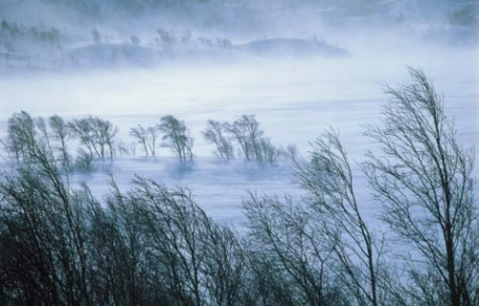
This is the season When mornings are dark. And birds do not sing In the woods and the park. This is the season When children ski. And Grandfather Frost Brings the New Year Tree.

Slide 10
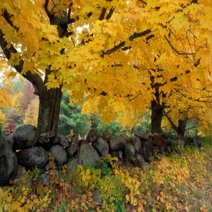
T: You’ve listened to the text and now be ready to do the following task. Say true or false.
1. Mag likes autumn very much.
2. Mag can ride a bike.
3. Tom likes poems about winter.
4. Mag don’t like to draw pictures.
5. She likes to see her friends at school

Slide 11
Физкультминутка.
Hand s up, clap, clap!
Hands down, clap, clap!
Turn yourself around and then you clap, clap!
Bend left, clap, clap!
Bend right, clap, clap!
Turn yourself around and then you clap, clap!

Slide 12
Составьте предложения из слов:
1. favourite, is, my, season, summer.
2. like, warm, I, weather.
3. people, usually, wear, shorts, and, T- shirts, in, this, season.

Slide 13
Thank you for your work. Good-bye.

